Slide 1
Problem Solving Using Computers
CPU Architecture

Slide 2

CPU Architecture
Internal structure and design of a Central Processing Unit (CPU),
How CPU processes instructions and manages data.

Slide 3
Key components Of CPU
Arithmetic Logic Unit (ALU): Executes arithmetic and logic operations.
Control Unit (CU): Directs the operations of the processor, managing the execution of instructions by the ALU.
Registers: Small, fast storage locations inside the CPU that hold data temporarily.

Slide 4
Cache: A small amount of high-speed memory located on or near the CPU to reduce the time it takes to access data from the main memory (RAM).
Clock Speed: The speed at which a CPU can execute instructions, measured in Hertz (Hz).
Instruction Set Architecture (ISA): Defines the set of instructions that the CPU can understand and execute (e.g., x86, ARM).

Slide 5
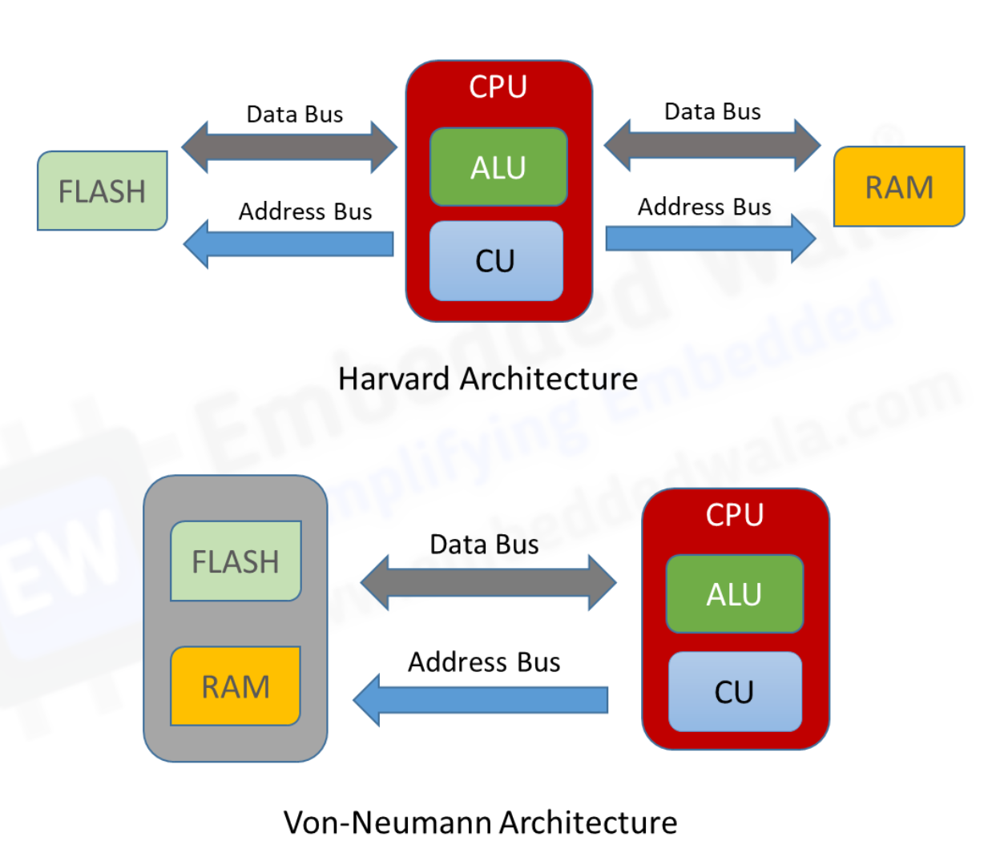

Slide 6
The Von Neumann architecture,
Foundational concept for most modern computer designs.
It was proposed by mathematician and physicist John von Neumann in the 1940s.
it describes a computing system where both data and program instructions are stored in the same memory. This concept is key to how most general-purpose computers operate today.

Slide 7
Key Features of Von Neumann Architecture:
Single Memory for Data and Instructions:
Both program instructions and data are stored in the same read-write memory. This is in contrast to Harvard Architecture, where program instructions and data are stored separately.
Sequential Execution of Instructions:
Instructions are executed one after the other in a linear fashion unless control instructions (like jumps or branches) are used.

Slide 8
Stored-Program Concept:
Programs are stored in memory alongside data, allowing the CPU to fetch instructions from memory, decode them, and execute them.
Central Processing Unit (CPU):
The CPU consists of a Control Unit (CU) and an
Arithmetic Logic Unit (ALU). The CU fetches instructions from memory and decodes them, while the ALU performs arithmetic and logic operations.

Slide 9
Memory:
The memory in a Von Neumann machine is a linear storage of addressable units. The CPU accesses the memory by addressing a particular location.
Input/Output (I/O) System:
The architecture allows data to be read from or written to input/output devices like keyboards, printers, or screens.

Slide 10
Advantages:
Flexibility: Programs can be easily modified and stored in memory.
Simplicity: The unified memory model simplifies hardware design.
General Purpose: This architecture is suitable for general-purpose computing.

Slide 11
Disadvantages:
Von Neumann Bottleneck: Since data and instructions share the same memory and bus, the CPU can be idle while waiting for data or instructions.
Slower Parallel Execution: Modern tasks like parallel computing are less efficient with this architecture compared to alternatives.

Slide 12
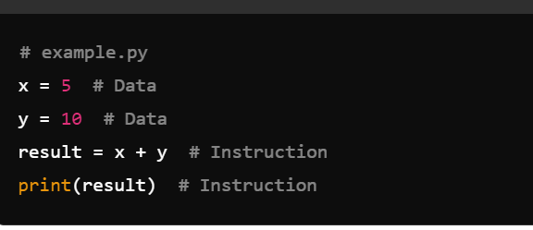

Slide 13
Characteristics of Harvard Architecture
Instructions and data can be fetched in parallel, improving performance.
Commonly used in embedded systems and microcontrollers.
Example: ARM microcontrollers, DSP processors.

